Slide 1




Slide 2
Introduction
What you need to know about programming

Slide 3
What are we covering
Hardware / Electronics
Configuration
Code structure
Code Changes

Slide 4
Hardware

Slide 5
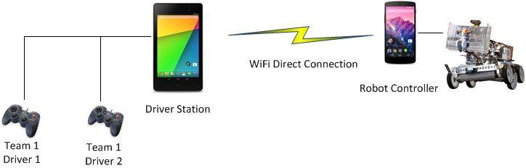
Point-to-Point System
Notes:
The system consists of a Driver Station (Android device, USB hub and gamepads) and a Robot Controller (mounted on robot). It is a point to point system. Each robot pair establishes its own unique WiFi Direct connection.
5

Slide 6
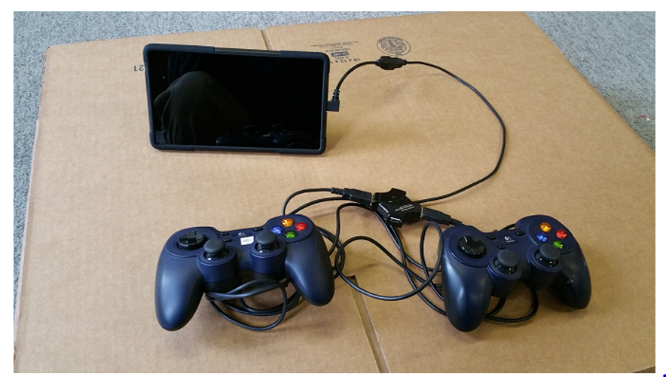
Driver station

Slide 7
Electronic Modules
USB-enabled modules from Modern Robotics
Power Module
Legacy Module
DC Motor
Servo
Core Device Interface (Advanced Sensor Module)
Legacy Module allows use of NXT-compatible devices
NXT Sensors
Tetrix DC Motor and Servo Controllers
Matrix 9V DC Motor/Servo Controller (coming soon)
LEGO NXT motors are NOT supported
Notes:
A set of USB-enabled hardware modules are available for the Android platform.
7

Slide 8
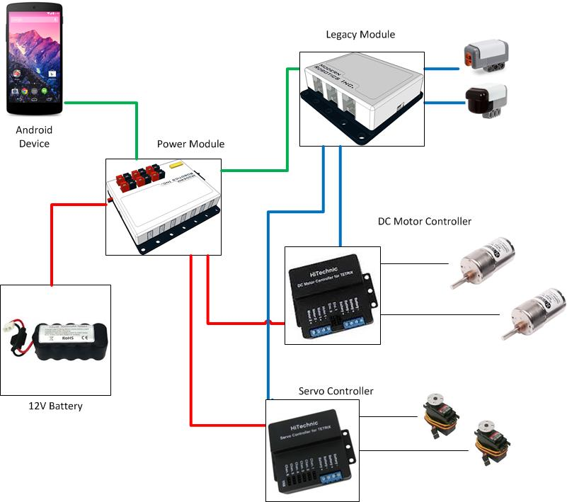
Support for Legacy Devices
Notes:
Note Android device (robot controller), 12V battery, Power Module and Legacy Module.
8

Slide 9
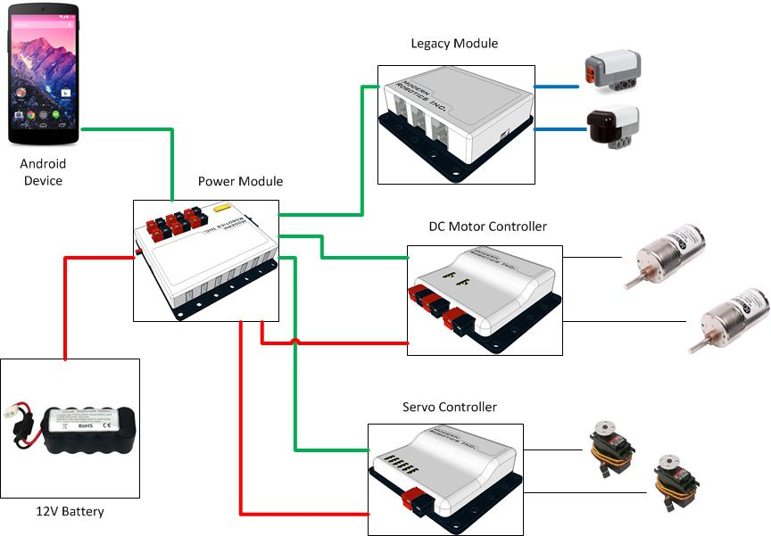
USB-Enabled Controllers
Notes:
9

Slide 10
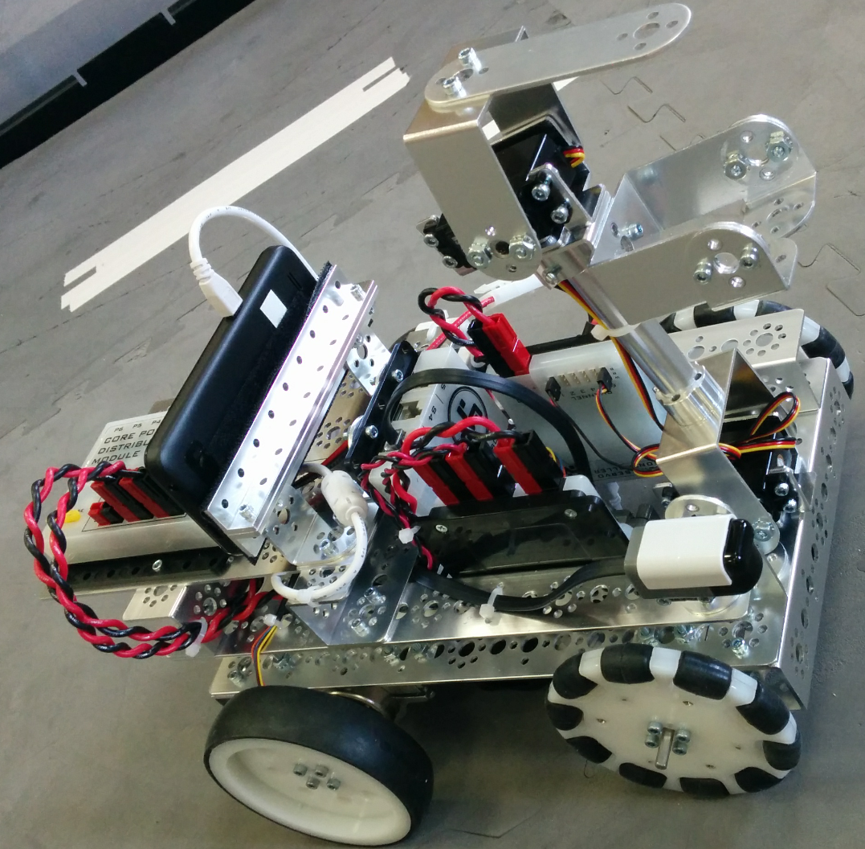
K9 Demo/Training Bot
Notes:
For today’s training, each team should have a pair of Android phones, and a K9 training bot.
If we can look at K9Bot we can see that it is equipped with a Power Module, a DC Motor Controller, a Servo Controller, and a Legacy Module.
Tom will do a quick demo of the bot.
Point out the following:
Driver station is paired to Robot Controller
Status info (including ping times and battery voltage) is relayed from robot and displayed onto driver station
Driver station can select and execute operational modes (or “op modes”)
Gamepad input can be used to control robot during driver controlled phase.
Telemetry info is relayed back from robot.
10

Slide 11
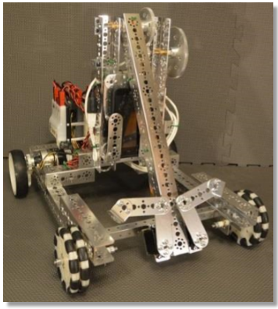
Push Bot
Notes:
For today’s training, each team should have a pair of Android phones, and a K9 training bot.
If we can look at K9Bot we can see that it is equipped with a Power Module, a DC Motor Controller, a Servo Controller, and a Legacy Module.
Tom will do a quick demo of the bot.
Point out the following:
Driver station is paired to Robot Controller
Status info (including ping times and battery voltage) is relayed from robot and displayed onto driver station
Driver station can select and execute operational modes (or “op modes”)
Gamepad input can be used to control robot during driver controlled phase.
Telemetry info is relayed back from robot.
11

Slide 12
Hardware Tips
Make sure the FtcRobotController app is the default app for your Modern Robotics hardware modules
Monitor the power levels on the main robot battery and each Android device
Notes:
12

Slide 13
Configuration

Slide 14
Why Do We Configure?
We need to tell the robot controller what devices are connected to the Android phone
App has the ability to scan and detect USB modules, but you still have to tell it what devices are connected to the modules.
The names you provide in the configuration file are the names that you will use to reference a device in your op mode.
Notes:
At this point, teams should attempt to launch the app, browse the existing configuration files, and configure the robot using their app. Make sure the power is turned on of the Power Module before you connect the phone to the Power Module.
Please refer to Section 8.2 in the training manual.
14

Slide 15
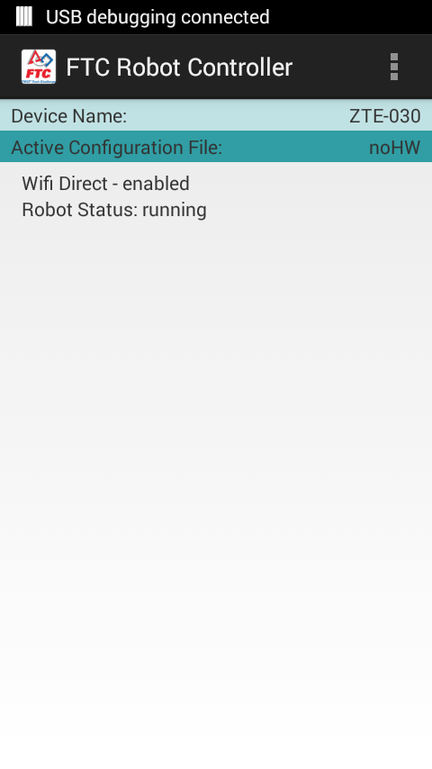
Who will be in charge of configuration
Are Builders or Programmers responsible for Robot configuration?
How to configure the robot:
Launch the Robot Controller app on the robot
Create a configuration file
Navigate the menus and screens comfortably
Notes:
At this point, teams should attempt to launch the app, connect the gamepad, assign the driver number for a gamepad, and get familiar with the driver station user interface.
Please refer to Section 8.2 in the training manual.
15

Slide 16
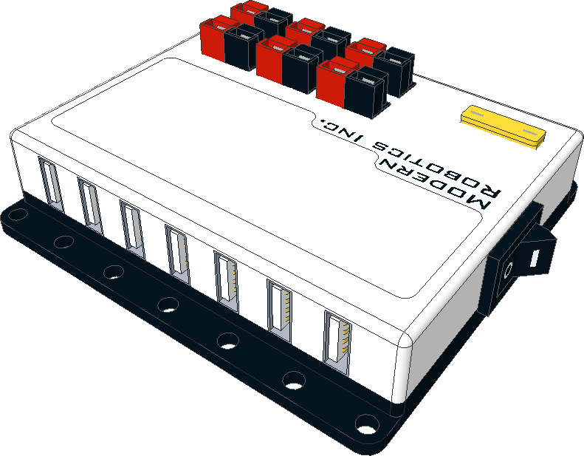
Serial Numbers…
Each device that is attached to the USB hub (Power Module) has its own serial number
When the Robot Controller scans the bus to look for devices, it identifies devices by serial number.
USB does not use the port number of the hub to identify a module.
Notes:
16

Slide 17
WiFi Direct
Android devices us WiFi Direct to connect/pair
Robot controller acts as group owner
Pairing is initiated from FTC Driver Station app
Some important tips
In general, devices should NOT be connected to any other wireless networks
Occasionally, it helps to clean up old, unused remembered WiFi direct connections
Notes:
17

Slide 18
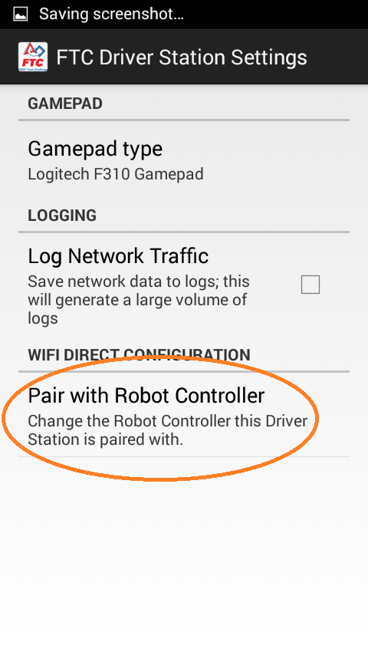
Who will be in charge of configuration
Are Builders or Programmers responsible for Robot configuration?
How to configure the robot:
Examine Driver Station’s Pair with Robot Controller screen
Look at available devices
Verify devices are paired
Notes:
18

Slide 19
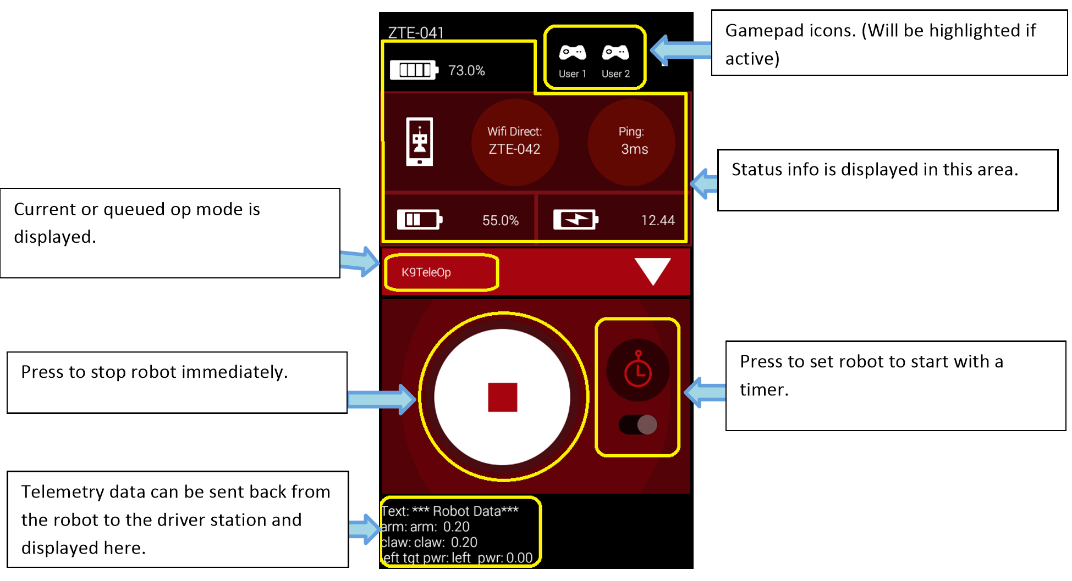
Operating the Robot
Robot Controller has pre-installed “K9” and “Pushbot” Op Modes
Notice the status information and telemetry information on Driver Station
Notes:
19

Slide 20
Configuration TIPS
Make sure the device names in your configuration file match the names exactly in your op mode

Slide 21
Code Structure

Slide 22
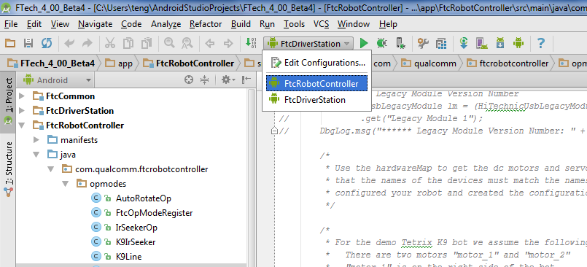
Android Studio
Available for free from Android Developer Website
Integrated Development Environment (IDE)
Text-based programming (Java)
Runs on Mac, Windows, and Linux
Notes:
22

Slide 23
What is an Op Mode?
An Op Mode is a java module (class) that a team will use in order to create custom behavior for their robot
During a match, Op Modes are executed on the robot controller, but are selected by the team from the driver station
Notes:
23

Slide 24
Setting Up Android Studio
Sean has complete instructions for this under development
Ms. Dubel’s computers will be setup shortly
Install Java
Install Android Studio
Install Github client
SDK Manager
Android 4.4.2 (API 19)
Open Project from version control
wfhs8499Robotics/ftc_app

Slide 25
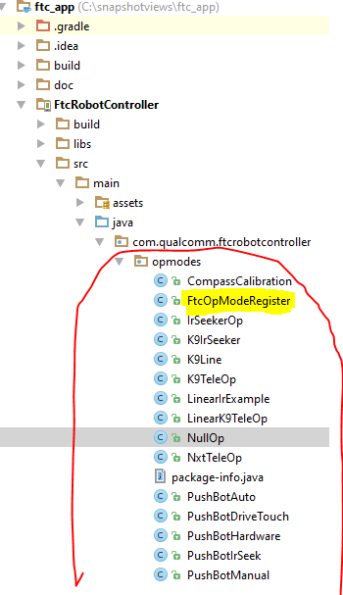
OpModes
Your robot code
Must extend OpMode
(or LinearOpMode)
Must be registered
FtcOpModeRegister

Slide 26
OpMode vs LinearOpMode
OpMode
LinearOpMode
You must override:
init()
loop()
Optional:
start()
stop()
Updates controllers:
Between loops
You must override:
runOpMode()
use waitForStart()
Beware if overriding init(), loop(),
start(), or stop()!
Updates controllers:
Via background thread
VS

Slide 27
OpMode vs LinearOpMode
OpMode
LinearOpMode
Natural fit for State Machines for autonomous
Works well for tele-op as well
Keep your loops fast!
Avoid wait statements
Use elapsed time instead
Use state across loop executions
Extends OpMode
Intended to be more like RobotC
Simple sequential statements for autonomous
Write your own while(true) loop for tele-op
Safer to use sleep() and waitOneHardwareCycle()

Slide 28
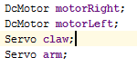
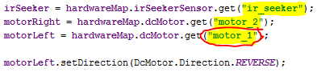
Motor & Sensor Setup
Declare at class level
Instantiate from HardwareMap
In your init() for OpMode
or in runOpMode() for LinearOpMode
**Use same names from Configuration File from your FtcRobotController app on phone**

Slide 29
HardwareMap Devices
dcMotorController
dcMotor
servoController
servo
legacyModule
deviceInterfaceModule
analogInput
digitalChannel
opticalDistanceSensor
touchSensor
pwmOutput
i2cDevice
analogOutput
accelerationSensor
compassSensor
gyroSensor
irSeekerSensor
lightSensor
ultrasonicSensor
voltageSensor

Slide 30
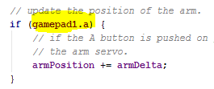
Gamepads
Use public variables (no getters)
float left_stick_x
float left_stick_y
float right_stick_x
float right_stick_y
boolean dpad_up
boolean dpad_down
boolean dpad_left
boolean dpad_right
boolean a
boolean b
boolean x
boolean y
boolean guide
boolean start
boolean back
boolean left_bumper
boolean right_bumper
boolean left_stick_button
boolean right_stick_button
float left_trigger
float right_trigger
byte user
int id
long timestamp

Slide 31
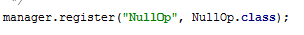
FtcOpModeRegister
Makes your OpModes appear in the Driver Station app
Name for your OpMode & it’s class
You can also comment out the defaults to clean up the driver station

Slide 32
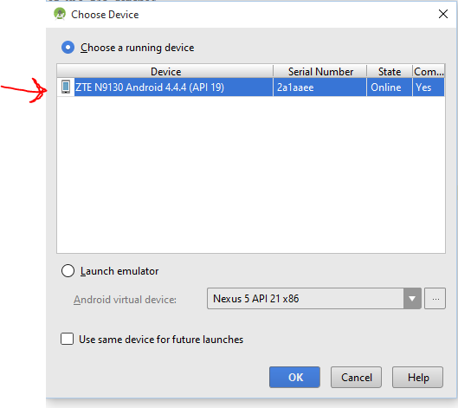
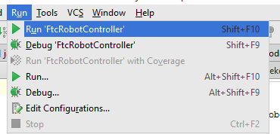
Downloading
Plugin phone running robot controller to PC
Run, Run ‘FtcRobotController’
Choose ZTE N9130 Android 4.4.4
After downloading, unplug phone & plug back into robot
Restart/re-power

Slide 33
Plugging and unplugging the USB is painful

Slide 34
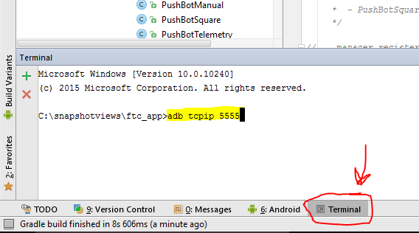
Wireless ADB
http://developer.android.com/tools/help/adb.html#wireless
PC & phone both on same Wi-Fi
Connect phone via USB
$ adb tcpip 5555
Disconnect USB
Find your phone’s IP address
Settings >About phone > Status > IP address
$ adb connect <phone’s IP>

Slide 35
Development Flow
Code
Download
Test
Build
Install
Connect
Get code (github)
commit code (github)

Slide 36
Documentation
With the ftc_app
PDF manuals
\ftc_app\doc\tutorial\
JavaDoc
\ftc_app\doc\javadoc\index.html
Online
FTC Technology Forum
http://ftcforum.usfirst.org/forumdisplay.php?156-FTC-Technology

Slide 37
Software Tips
Make sure the device names in your configuration file match the names exactly in your op mode
Use debug statements (DbgLog), telemetry, ADB, and log files to help debug your op modes
Refer to the javadoc for information about the classes and their member variables and methods
Notes:
37

Slide 38
General Tips
Use available tools to help troubleshoot issues with a robot
Ping time (indicates network quality and robot controller availability)
Battery voltage
Log files (via app or using ADB to pull from device)
Telemetry
ADB
Make sure cables are secured and too tight
Make sure Android device is properly mounted
Secure, Protected, But not obscured by too much metal (it’s a wireless device)
Notes:
Log files are stored on each device as
/sdcard/com.qualcomm.ftcrobotcontroller.logcat
/sdcard/com.qualcomm.ftcdriverstation.logcat
Android Debug Bridge | Android Studio - Android Developers
38

Slide 39
For Additional Information…
http://ftcforum.usfirst.org/forumdisplay.php?156-FTC-Technology
Intelitek
Notes:
39

Slide 40
Q&A

Slide 41
Backup

Slide 42
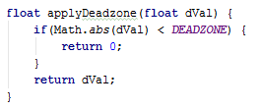
Deadzones
Ignore setJoystickDeadzone() in Gamepad
Isn’t used anywhere…
Set them the old-fashioned way yourself

Slide 43
Wireless Tips
Before event scan your venue
Use pair of Android devices and monitor network channels using the ping time
Use WiFi Analyzer to detect other WiFi networks
Coordinate with IT staff to disable WiFi suppressors
Make sure teams’ Android devices are not connected to other networks
Notes:
43

